Slide 1
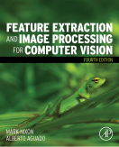
Lecture 2 Image Formation
COMP3204 Computer Vision
What is inside an image?
 | Book pp 37-42

Slide 2
Content
How is an image formed?
What restrictions are there on image formation?
Bonjour Monsieur Fourier …..

Slide 3

Decomposing an image into its bits
The Most Significant Bit carries the most information where as bit 0 is noise
… and here, bit 4 is the lighting

Slide 4
Effects of differing image resolution
Low resolution lose information but N×N points implies much storage
How do we choose an appropriate value for N?

Slide 5
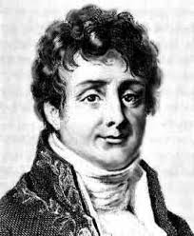
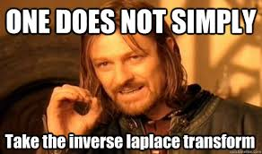
Jean Baptiste Joseph Fourier
Any periodic function is the result of adding up sine and cosine waves of different frequencies
Sceptical? Yeah, so were Lagrange and Laplace. Good company eh?
“Fourier’s treatise is one of the very few scientific books that can never be rendered antiquated by the progress of science” James Clerk Maxwell 1878
Fourier 10 Laplace 0 …

Slide 6
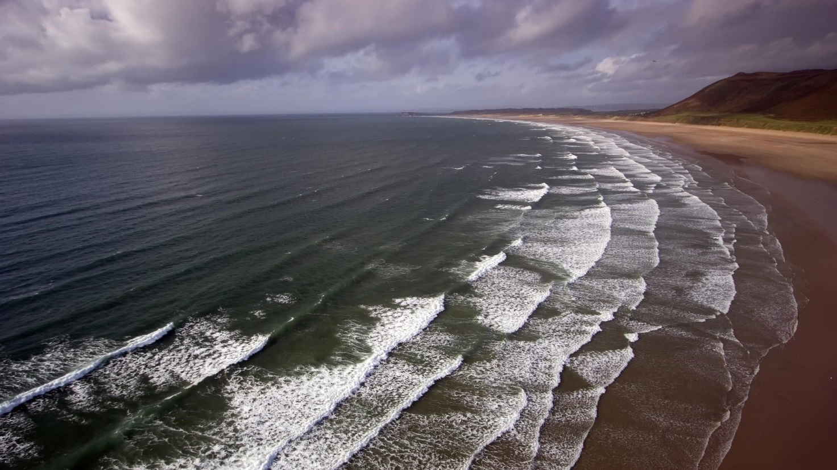
What are 2D waves?
2D waves are along x and y axes simultaneously

Slide 7
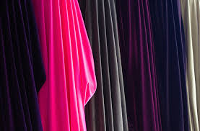
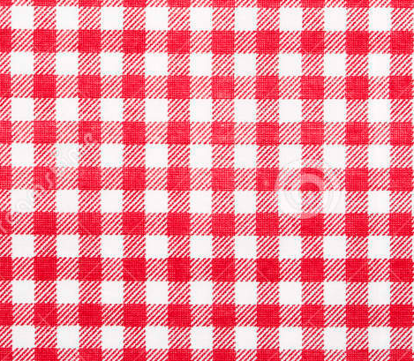
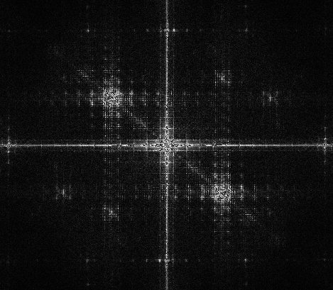
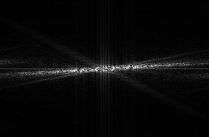
and in terms of frequency
N.b. colour immaterial (just for visuals)

Slide 8
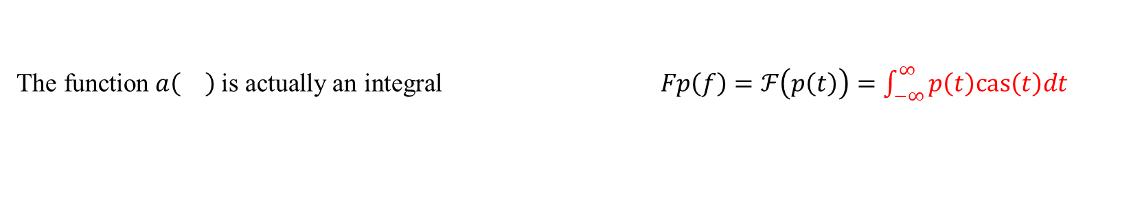
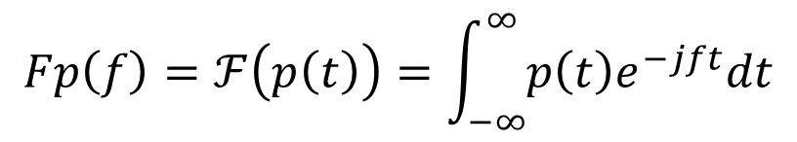

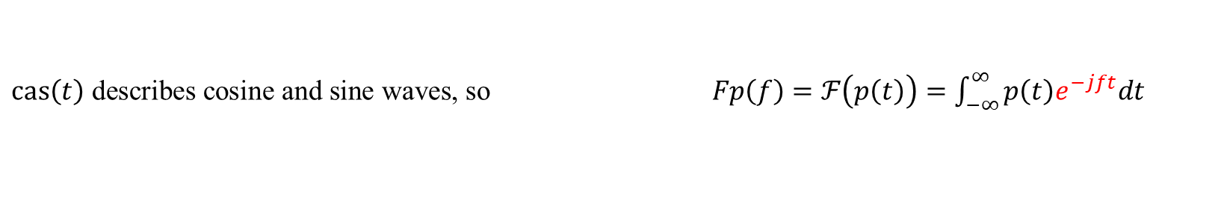
Step up Monsieur Fourier…
$$Fp\left(f\right)=ℱ\left(p\left(t\right)\right)=\int_{−∞}^{∞}{p\left(t\right)e^{−jft}dt}$$
Whoa! WTF! Where from….
First, we have that the FT is a function $a\left(\right)$of a time-variant signal $p\left(t\right)$
The Fourier transform is then $Fp=a\left(p\left(t\right)\right)$
The transform is a function of frequency so $Fp\left(f\right)=a\left(p\left(t\right)\right)$
$ℱ$ stands for the Fourier transform so $Fp\left(f\right)=ℱ\left(p\left(t\right)\right)=a\left(p\left(t\right)\right)$
The function $a\left(\right)$is actually an integral $Fp\left(f\right)=ℱ\left(p\left(t\right)\right)=\int_{−∞}^{∞}{p\left(t\right)cas\left(t\right)dt}$
$cas\left(t\right)$ describes cosine and sine waves, so $Fp\left(f\right)=ℱ\left(p\left(t\right)\right)=\int_{−∞}^{∞}{p\left(t\right)e^{−jft}dt}$
where $cas$ = ‘cos and sin’ since $e^{−jft}=\cos\left(ft\right)−j sin\left(ft\right)$ ,
where $j$ is the complex number $j=\sqrt{−1}$

Slide 9
What does the Fourier transform do?
Addition in the time domain
Separation in the frequency domain

Slide 10
Fireside time
How did I get into computer vision?

Slide 11
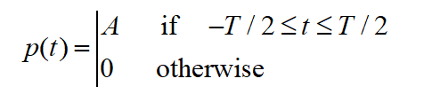
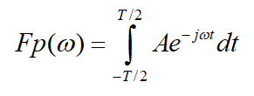
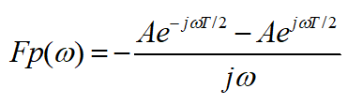
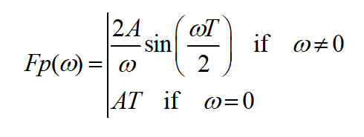
Zut alors! On doit applique ca
Pulse
Use Fourier
Evaluate integral
And get result

Slide 12

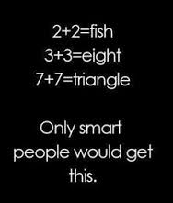
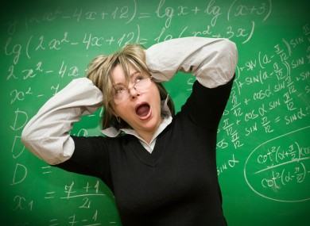

Google “are you frightened of maths”

Slide 13
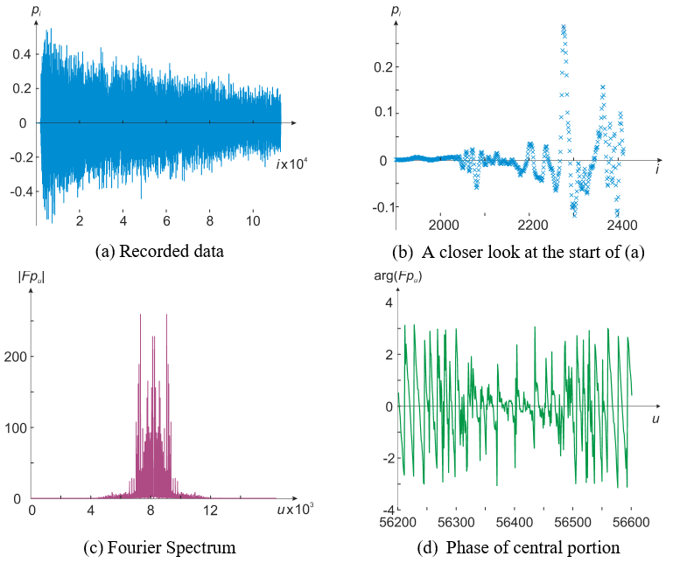
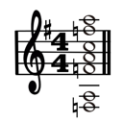
Hard day?
Let’s see the Fourier transform of the Hard Day’s night chord
Apparently, the piano is more dominant than expected

Slide 14
A pulse and its Fourier transform

Slide 15
Reconstructing a signal from its Fourier transform
This is the inverse Fourier transform
Fourier transform

Slide 16
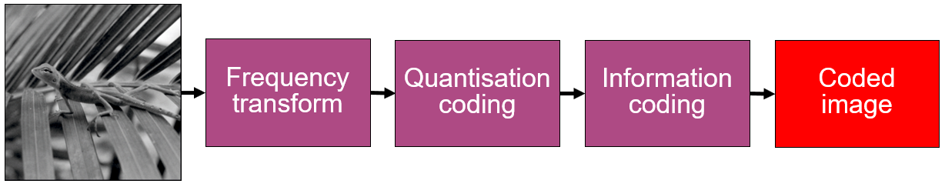
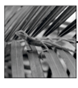
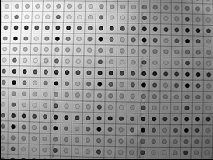
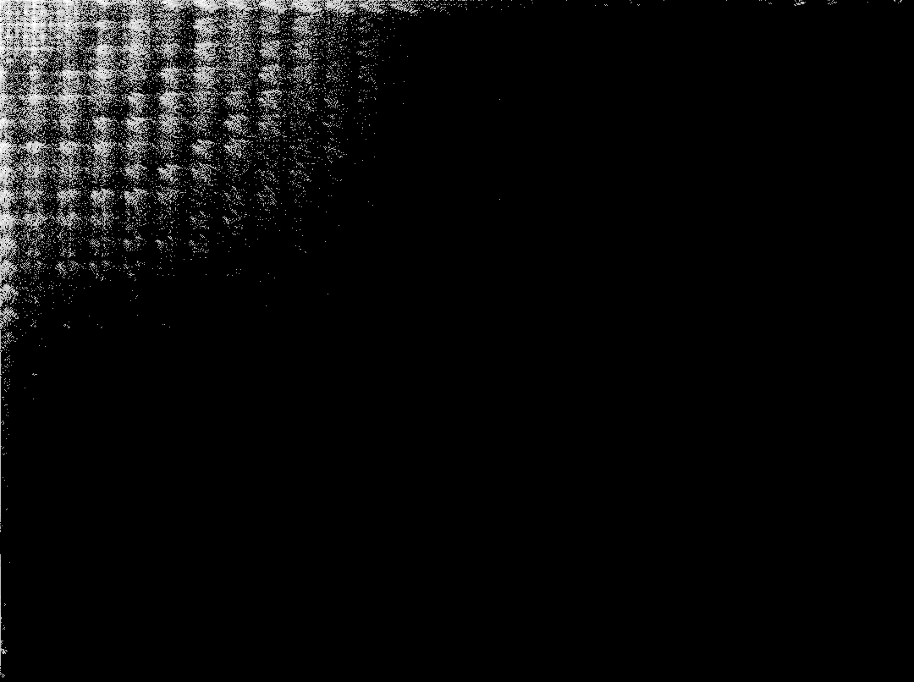
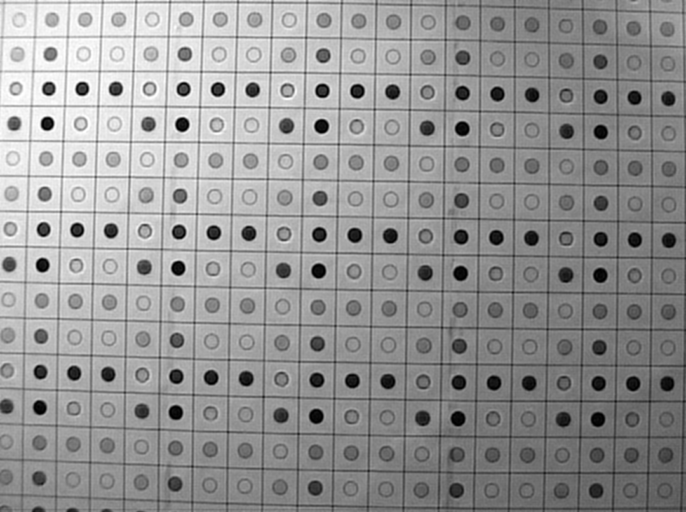
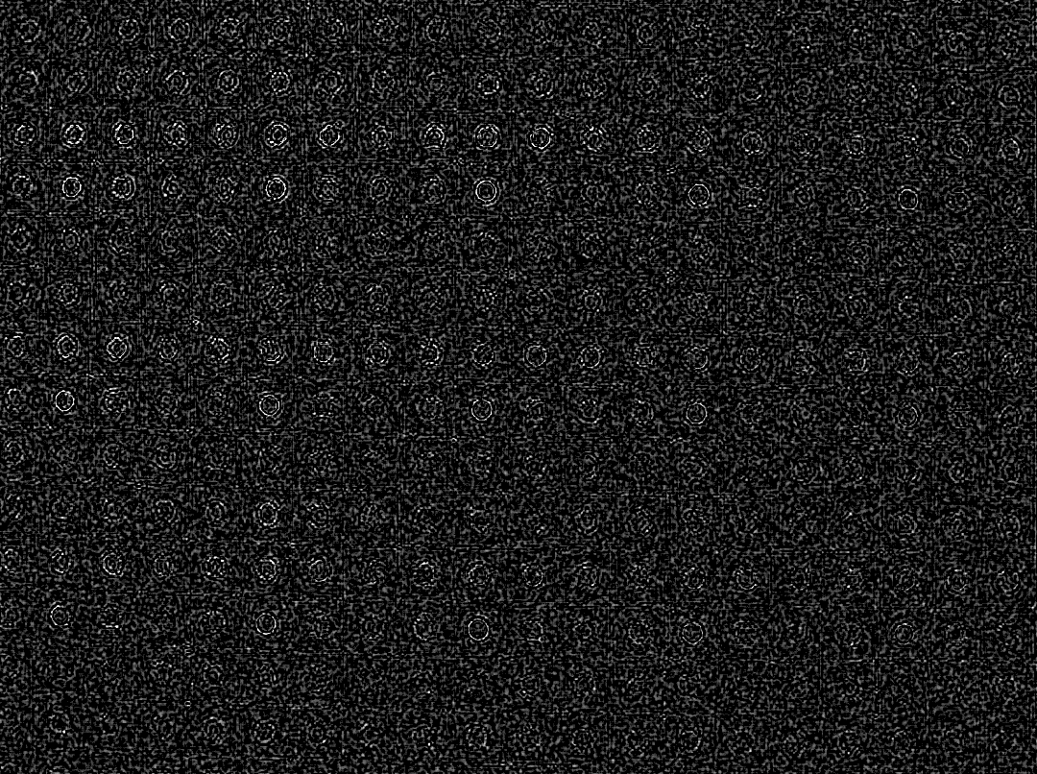
Inverse Fourier transform is used for reconstruction
Fourier transform
Inverse Fourier transform
5% of transform components
image
reconstructed image
error

Slide 17
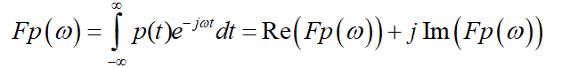
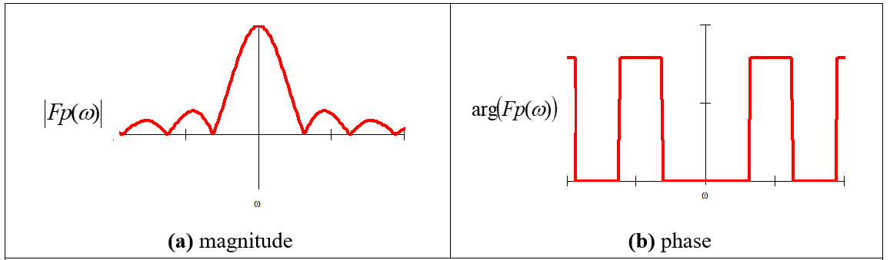
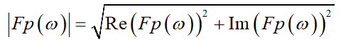
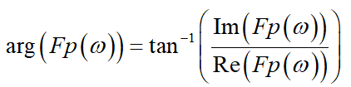
Magnitude and phase of Fourier transform of a pulse

Slide 18
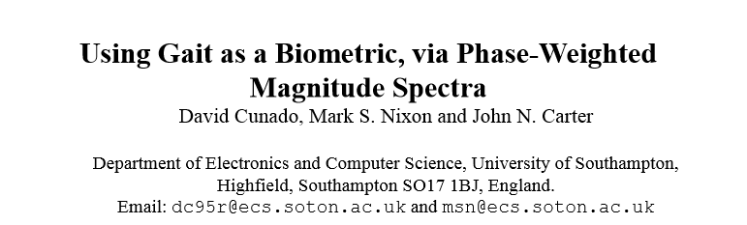
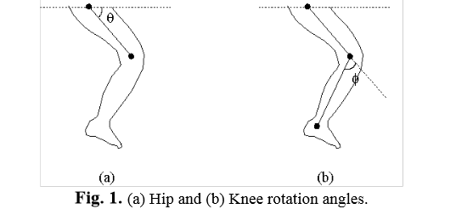
http://eprints.soton.ac.uk/250040/1/cunado_avbpa.pdf

Slide 19
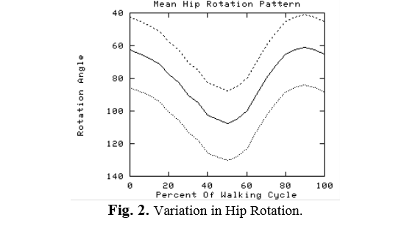
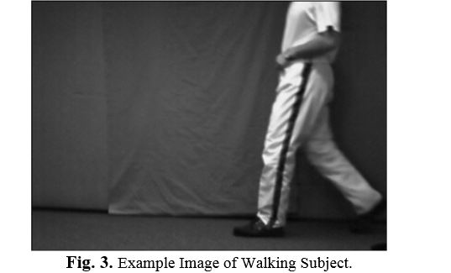
Gait patterns (angle of swinging leg)

Slide 20
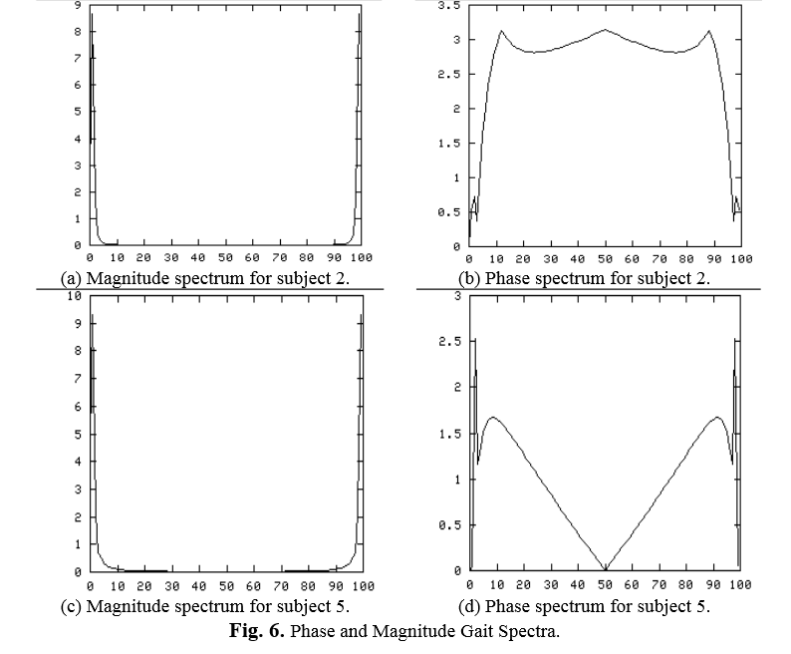
Gait magnitude and phase

Slide 21
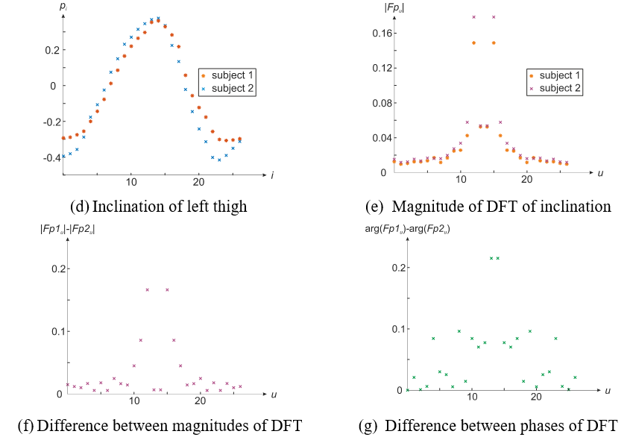

Slide 22
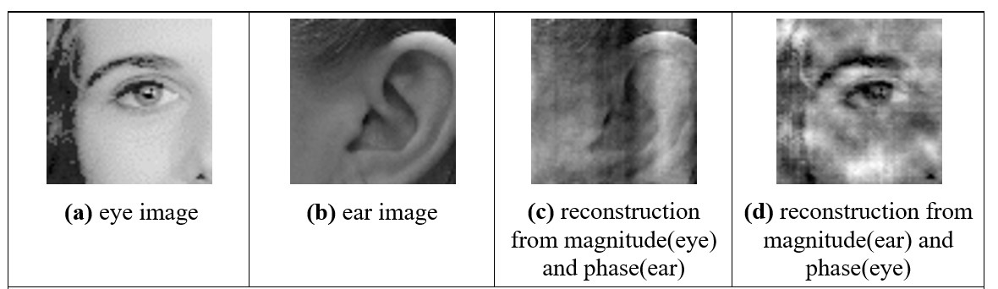
Illustrating the importance of phase

Slide 23

Takeaway time –main points
1 – sampling data is not as simple as it appears
2 – sampling affects space and brightness
3 – Fourier allows us to understand frequency
4 – Fourier allows for coding and more
Next, Fourier will allow us to understand sampling
Notes:
Mangos in portswood, yum yum

